Slide 1

STUDENT PORTFOLIO

Slide 2
STUDENT DETAILS
NAME: Gowthami Machiraju
REG NO: AP22110011148
SRM UNIVERSITY AP

Slide 3
PROJECT TITLE/PROJECT STATEMENT
:
•
.
,
.
,
.
Many
;
Project Title:
Student Portfolio
Problem Statement:
Solution:
To address the challenges students face in showcasing their skills and projects comprehensively, we propose developing an online portfolio. This digital platform will serve as an interactive and dynamic representation of their abilities, experiences, and achievements.
Many students find it challenging to showcase all their skills and projects through traditional resumes and cover letters. These conventional methods often fail to provide a comprehensive picture of their capabilities, leading to missed job opportunities. Furthermore, without an online presence, students struggle to get noticed and network with potential employers or collaborators.

Slide 4
AGENDA
The agenda for creating a student portfolio is to develop a dynamic online platform that allows students to effectively showcase their skills, projects, and achievements. This portfolio aims to enhance their professional visibility, providing a comprehensive view of their capabilities to potential employers and collaborators.By offering a centralized, easy-to-navigate space for their work, the portfolio will facilitate Better networking opportunities and improve their chances of securing job offers and internships.The ultimate goal is to create an engaging and professional online presence that accurately reflects the student's talents and ambitions.

Slide 5
PROJECT OVERVIEW
It provides a detailed and interactive view of their abilities, making it easier for potential employers and collaborators to see what they can do. The portfolio usually includes an introduction, project descriptions, and contact information, often with images and videos. This digital presence helps students stand out in the job market and makes it easier to network and find job opportunities.
Key Features:
1. Home Page:
-Introduction with a professional bio and photo.
-Navigation for easy access to different sections
2. About Me:
-Details of interests, and career goals.

Slide 6
3. Skills Showcase:
-List of technical and soft skills with proficiency levels
4. Projects Display:
-Showcase of completed projects with descriptions, technologies used.
5. Services Offered:
-Description of services the student can provide, such as web development or design.
6. Contact Information:
-Contact form for inquiries and networking opportunities.
- Links to social media profiles and email address.

Slide 7
Who are the end users of this project ?
The primary end users of a student portfolio are potential employers who use it to assess the student's skills, projects, and qualifications for job opportunities. Collaborators benefit as well, as the portfolio provides a detailed view of the student's work, making it easier to identify potential partnerships for projects or research. Academic institutions, including professors, advisors, and admission committees, use the portfolio to evaluate the student's work for internships, scholarships, or further education. Peers and colleagues in the same field may review the portfolio for insights, feedback, and networking opportunities. Clients seeking to hire the student for freelance or contract work also rely on the portfolio to understand the student's capabilities. Finally, the portfolio serves the student by allowing them to self-assess, track progress, and reflect on their achievements and growth over time.

Slide 8
Your solution and its value proposition
The project aims to create a personal portfolio website using HTML, CSS, and JavaScript, enabling students to effectively showcase their abilities, projects, experiences, and achievements.
Key Features:
Skill and Project Showcase:
The portfolio will comprehensively highlight the student's technical and artistic abilities through detailed descriptions and multimedia presentations of their projects.
Each project will include explanations of methodologies, technologies used, and outcomes, providing a clear demonstration of the student's expertise.
Interactive Elements:
JavaScript will be utilized to incorporate interactive elements like project demos, animations, and dynamic charts.
These features will engage visitors and offer an interactive experience that enhances understanding of the student's capabilities.
User-Friendly Design:
Designed to be visually appealing and responsive across devices, the portfolio will offer an intuitive navigation experience.
It aims to improve the student's networking opportunities by serving as a professional platform for potential employers and collaborators.
Enhancing Career Opportunities:
By showcasing a diverse range of skills and projects, the portfolio aims to boost the student's visibility and credibility in the job market.
It will effectively attract job offers, internships, freelance work, and collaboration opportunities.
Reflection and Growth:
Beyond showcasing current achievements, the portfolio will enable ongoing reflection and growth tracking.
Updates will be facilitated to reflect new skills, experiences, and professional development milestones.

Slide 9
How did you customise the project ?
The purpose of my personal portfolio is to display my skills, projects, and achievements professionally. It helps me show potential employers and collaborators what I can do, making it easier to connect with opportunities that align with my career ambitions.
1.Personalized Content and Design:
-Custom logos, colors, fonts, detailed bio, skills, projects, and testimonials reflecting my unique style and professional identity.
2. Interactive Elements:
-implemented animations, hover effects, and dynamic content using JavaScript to enhance user engagement
3. Responsive Design:
-Ensured the site is mobile-friendly and looks great on all devices through responsive CSS and media queries.
4. User Experience Enhancements:
- Simplified navigation, added smooth scrolling, and incorporated a sticky navbar for better usability.

Slide 10
MODELLING
Structure and Layout:
Designed with sections such as Home, About, Services, Skills, Projects (or Teams), Contact, andFooter
The portfolio uses a combination of grid and flexbox layouts alongside responsive design principles to ensure optimal display across devices.
Navigation and User Interface:
Implemented a navbar with smooth scrolling and possibly a sticky feature for easy navigation.
Ensured responsive design for seamless viewing on various devices.
Content Organization:
Structured content to provide clear information about skills, projects, and personal details
Used visual elements like images, icons, and animations to enhance engagement.
Interactive Elements:
Integrated interactive features like hover effects, dynamic content, and possibly a carousel for project showcases.

Slide 11
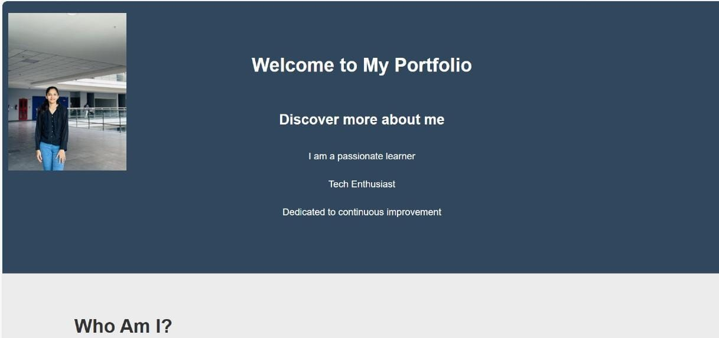
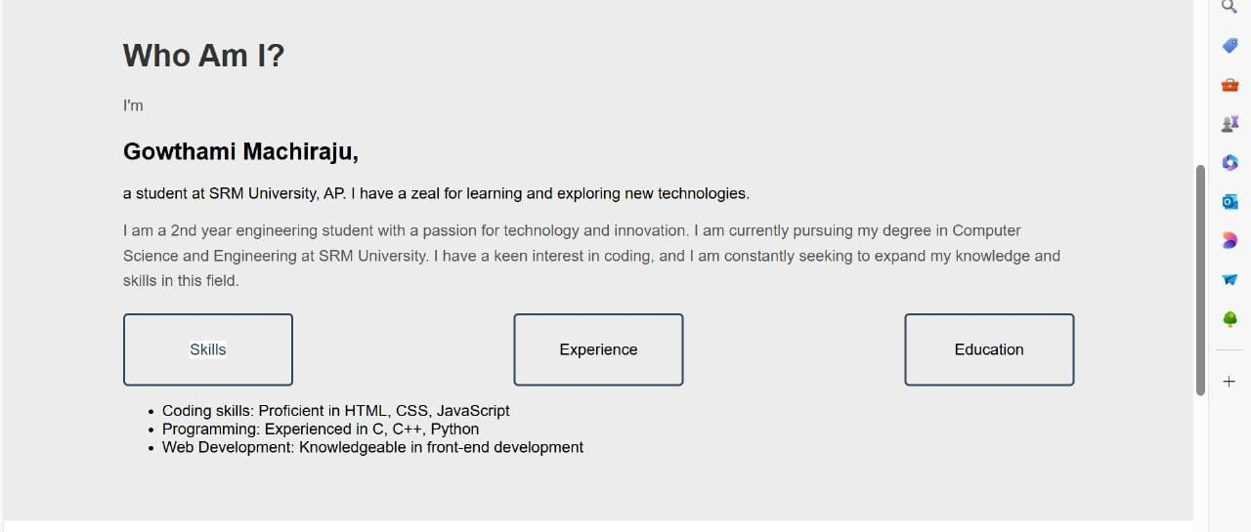
OUTPUT IMAGES

Slide 12
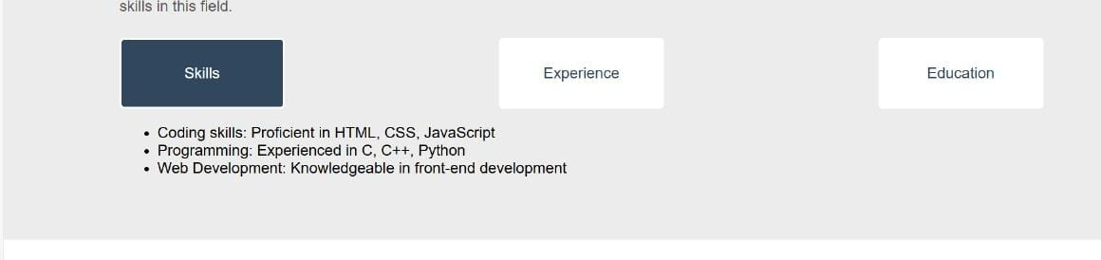
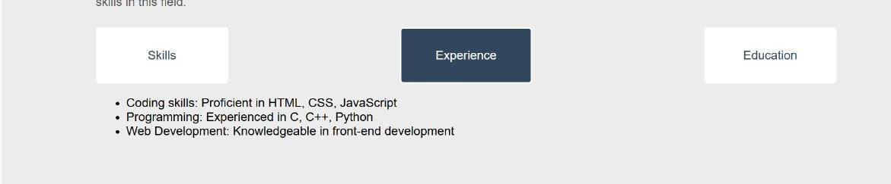
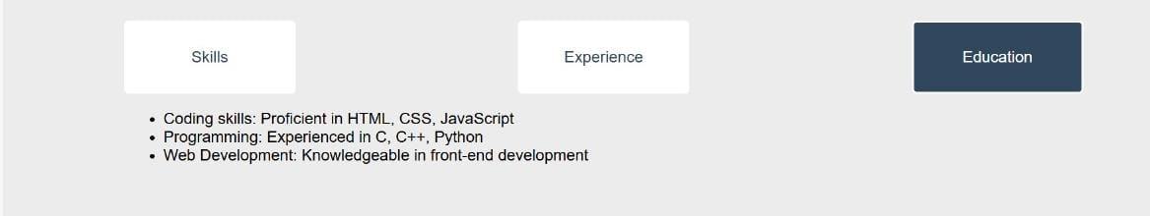

Slide 13
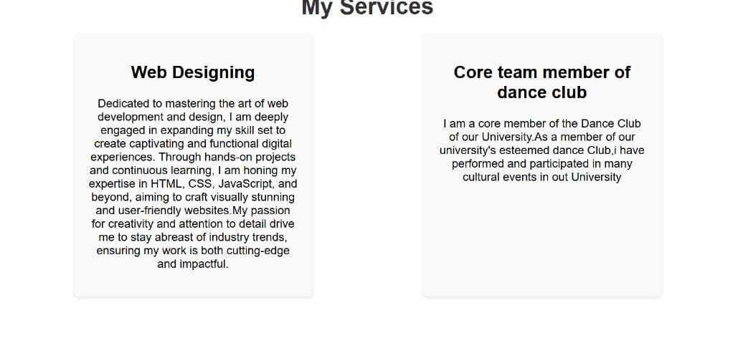
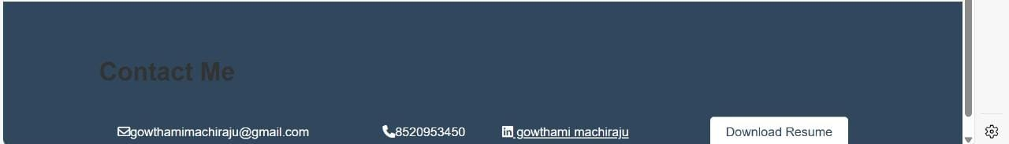

Slide 14
REFRENCE LINKS
1. https://frontendmasters.com/
2. https://www.w3schools.com/howto/howto_blog_become_frontenddev.asp

Slide 15
Thank you

